Slide 1


1. To learn to write about the best places / things in your city
2. To learn the patterns:
Which is the best town /city?
… has the best …
… is the best because …
… is better than …, but … is the most …

Slide 2


Who’s got talent in your class? Give your reports.
1. … is the best chess player.
2. … is the most talented dancer.
3. … is the most interesting writer.
4. … is the fastest runner.
5. … is the best basketball player.
6. … is the best English speaker.
7. … is the funniest actor.
8. …

Slide 3
Review the phrases.
have … in common
1. 有相同特征 _______________________
2. 各种各样的 _______________________
3. 由……决定 _______________________
4. 发挥作用 _______________________
all kinds of
be up to
play a role
make up
5. 编造 _______________________
6. 例如 _______________________
7. 认真对待 _______________________
8. 给某人某物 _______________________
for example
take … seriously
give sb. sth. / give sth. to sb.

Slide 4


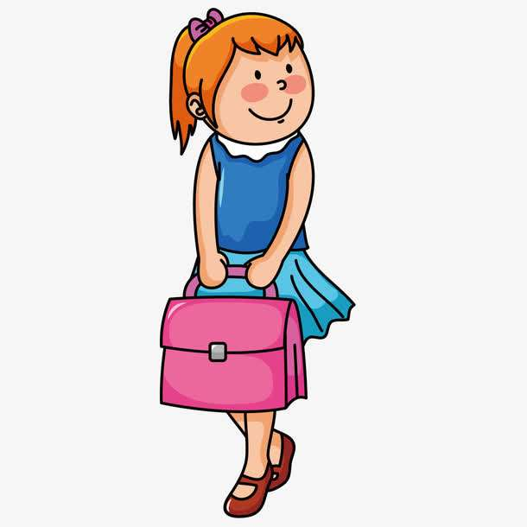
Where is your favorite place to go on weekends? Why?
The Teenagers’ Activity Center is my favorite place to go on weekends, because I can play tennis there. And I can speak English with friends.

Slide 5
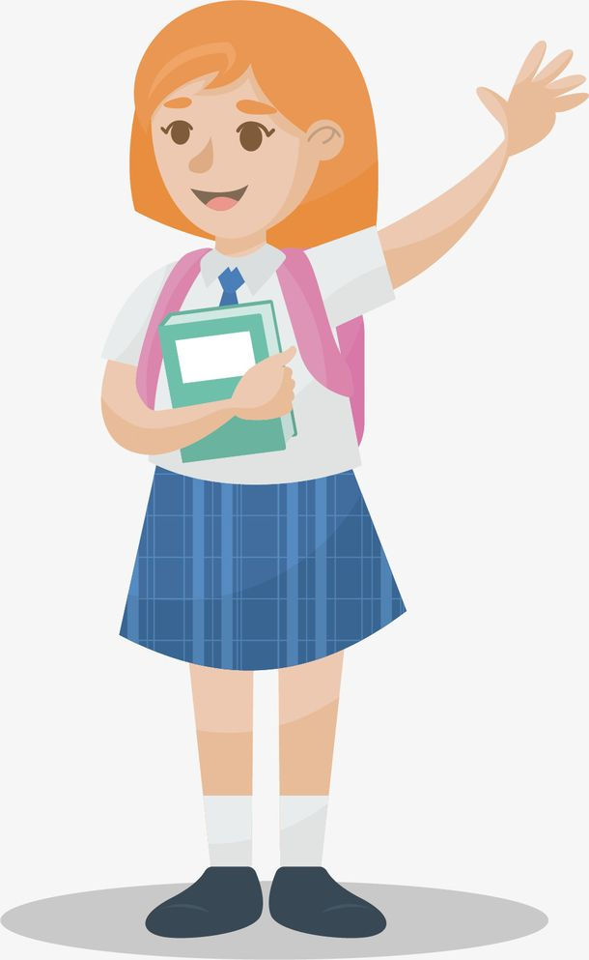
My favorite place to go is Center Park because I can climb the hill and fly kites there.

Slide 6

Unit 4

Slide 7
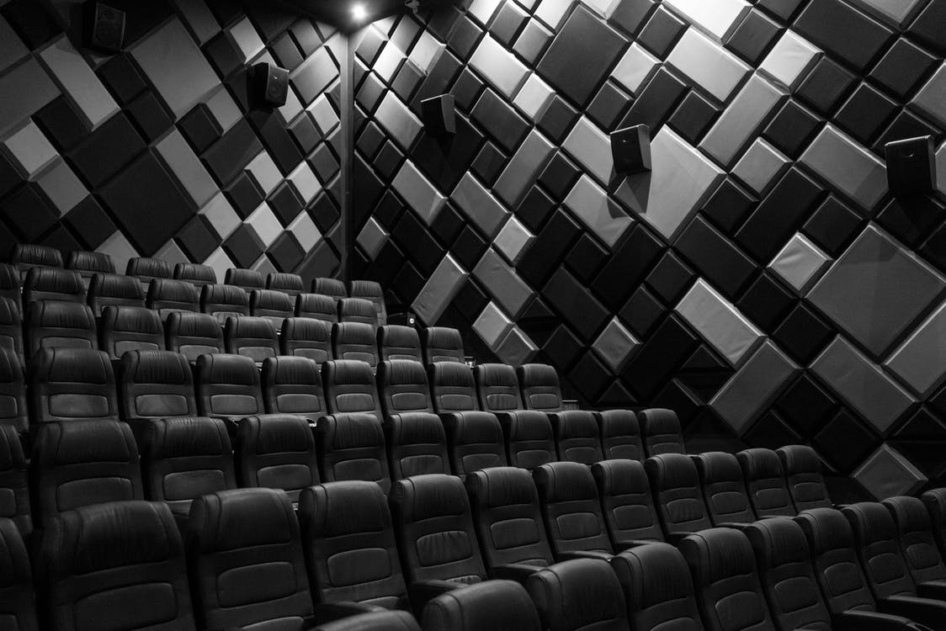
Unit 4
What's the best movie theater?

Slide 8
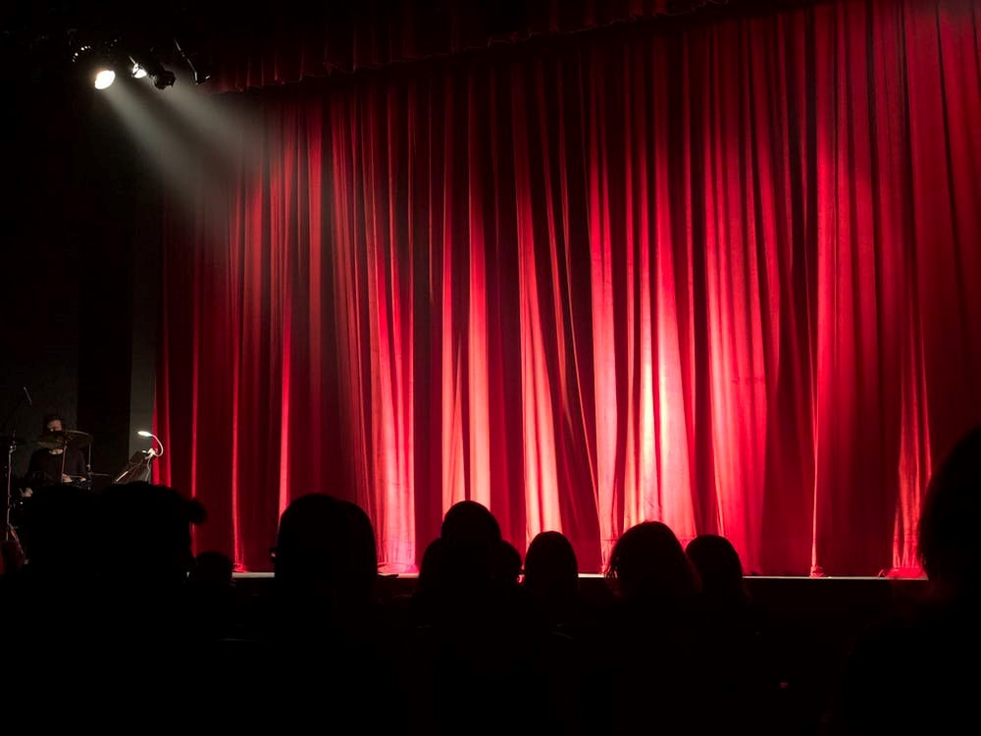


Slide 9


Read the article about Greenwood Park. Fill in the blanks with the correct superlative forms of the adjectives and adverbs in the box.
crowded creative good fast quietly
adj. 人多的; 拥挤的; 挤满的
Greenwood Park is the best place to go to on weekends. I always finish my breakfast ___________ on Saturdays because I want to get to Greenwood Park before 10:00 a.m. to meet my friends. The park is ________________ place on weekends because almost everyone goes there to see the street performers.
(the) fastest
the most crowded

Slide 10
crowded creative good fast quietly
Some people think they are boring, but I think they are ________________ people. However, the place where you can enjoy your time ________________ is at one of the small coffee shops near the park. You can read or relax there. There is something for everyone at Greenwood Park.
the most creative
(the) most quietly

Slide 11
Why does the writer go to the Greenwood Park?
To meet friends.
To see the street performers.
To read or relax in one of the small coffee shops near the park.

Slide 12


1. Fill in the blanks with the superlative forms of the words in the box.
good cheap popular comfortably bad
1. Dumpling House is ________________ restaurant in the city. You can get a big plate of dumplings for only five yuan.
2. Spring Park is ________________ place in the city on weekends. Many families go there with their young children. Lots of old people like to take walks there, too.
the cheapest
the most popular

Slide 13
good cheap popular comfortably bad
3. You can rest ____________________ at Flower Hotel. Their rooms are clean and big.
4. 109.9 FM plays ________________ music. The songs are always boring and too loud.
5. PEP High School is _____________ school in this town. They have big classrooms, fantastic teachers and an excellent sports center.
(the) most comfortably
the worst
the best

Slide 14
2. Read the information. Then correct the mistakes(改正错误) in the sentences below.
A movie ticket at Town Cinema is $12.00. It is $10.50 at Screen City, and $10.00 at Movie World.
Screen City is always very crowded. Many people go to Movie World, too. But you can always get a ticket at Town Cinema.
The seats at Movie World are very comfortable. The seats at Screen City are a little hard. The Town Cinema seats are very uncomfortable.

Slide 15
1. Movie World is the most expensive.
2. Screen City has the cheapest tickets.
3. Town Cinema is more popular than Screen City.
Town Cinema is the most expensive./
Movie World is the cheapest.
Movie World has the cheapest tickets.
Screen City is more popular than Town Cinema./
Town Cinema is less crowed than Screen City.

Slide 16
4. Movie World is the most popular.
5. Town Cinema has the most comfortable seats.
Screen City is the most popular.
Movie World has the most comfortable seats.

Slide 17


Slide 18
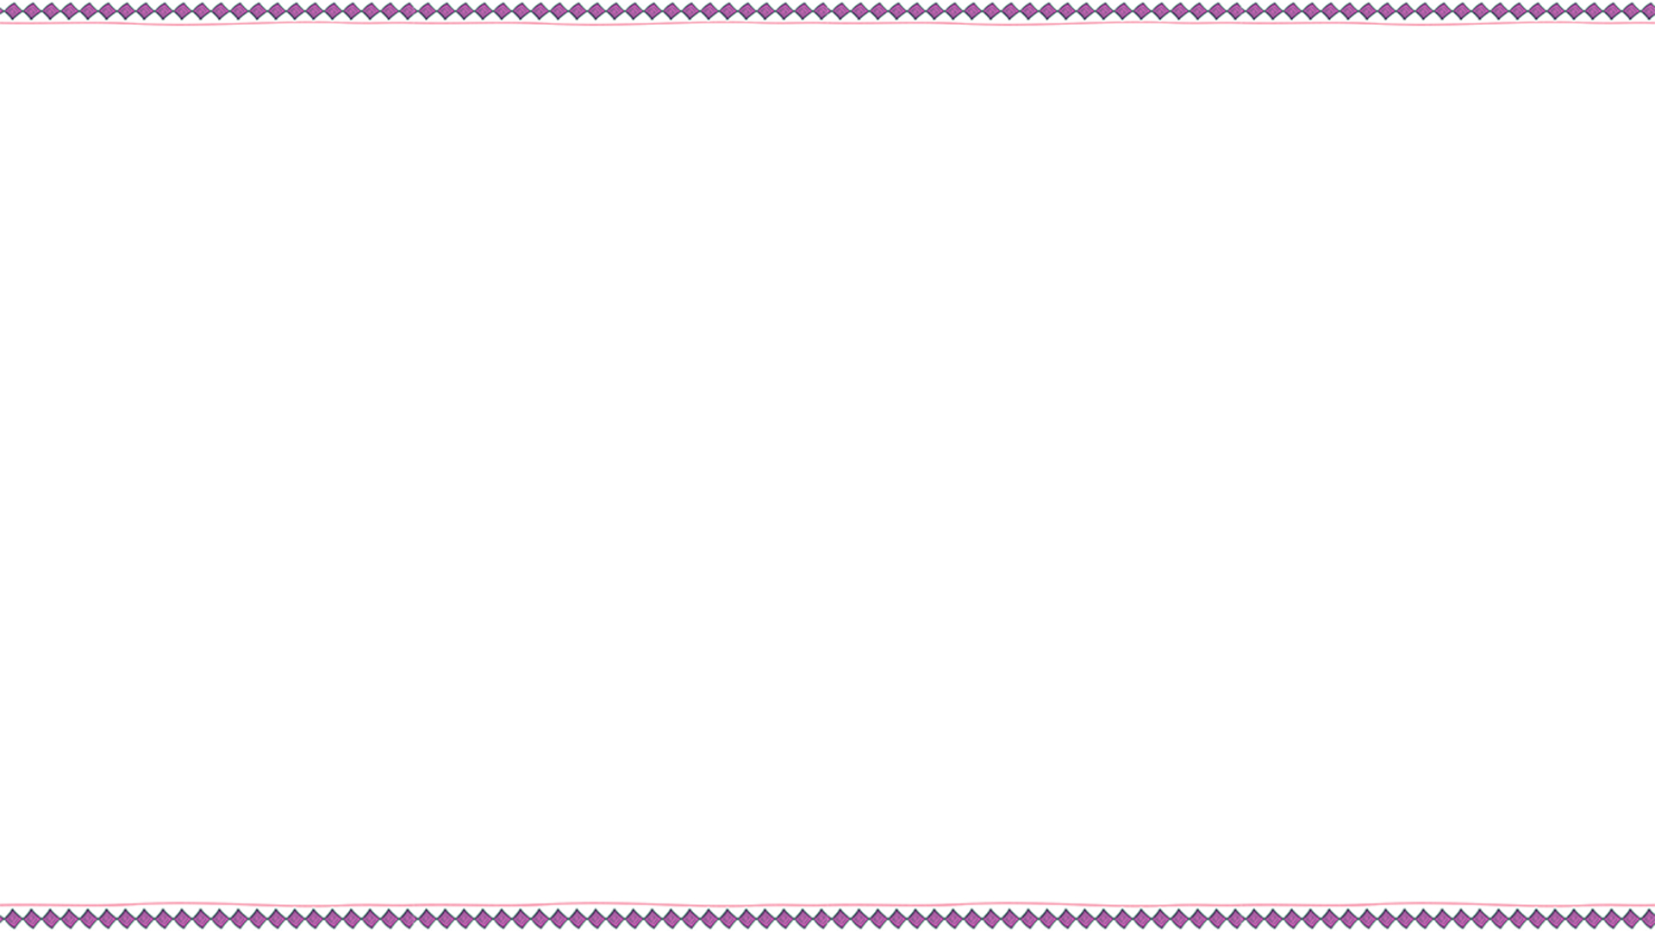

Think about some of the best places in your town/city. Why are they the best?
Best places in my town/city |  | Why?
best middle school | No. 1 Middle School | Because it is the most beautiful school in my town.It has big classrooms, fantastic teachers and an excellent sports center.
best movie theater
Movie World

Slide 19
头脑风暴(笔记)
If we want to choose a best movie theater, we should think about：
品质【comfortable seats, the biggest screens, the best sound, the newest and most popular movies, the cleanest, the biggest】
价格【buy tickets cheaply】
服务【buy tickets quickly; the shortest waiting time; the friendliest waiters】
距离【be close to home; in the center of the town/city】

Slide 20

品质/服务/价格/距离
Best places in my town/city |  | Why?
the most delicious food;
the cleanest environment
best restaurant
Rui Jia Restaurant
best
clothes store
the most newest and the most fashionable clothes
Fashion Time
best
supermarket
New Century Supermarket
the freshest food;
not expensive

Slide 21
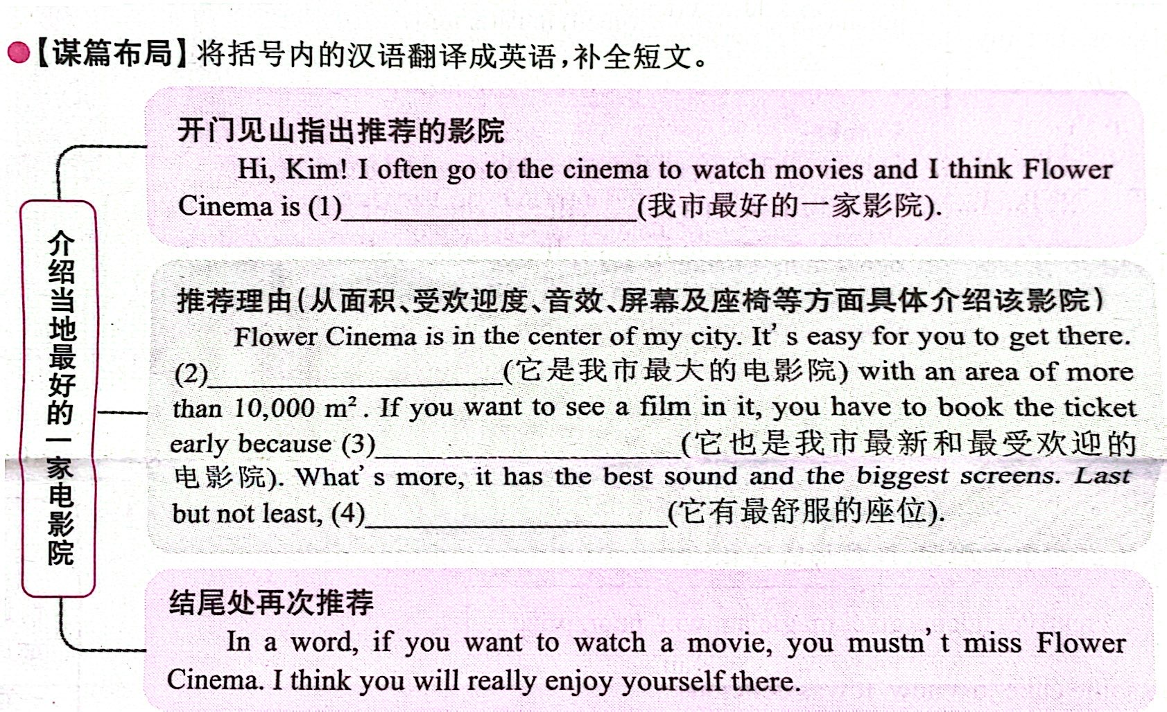
the best movie theater
in my city
It’s the biggest cinema in the city
it’s the newest and most popular cinema
it has the most comfortable seats

Slide 22
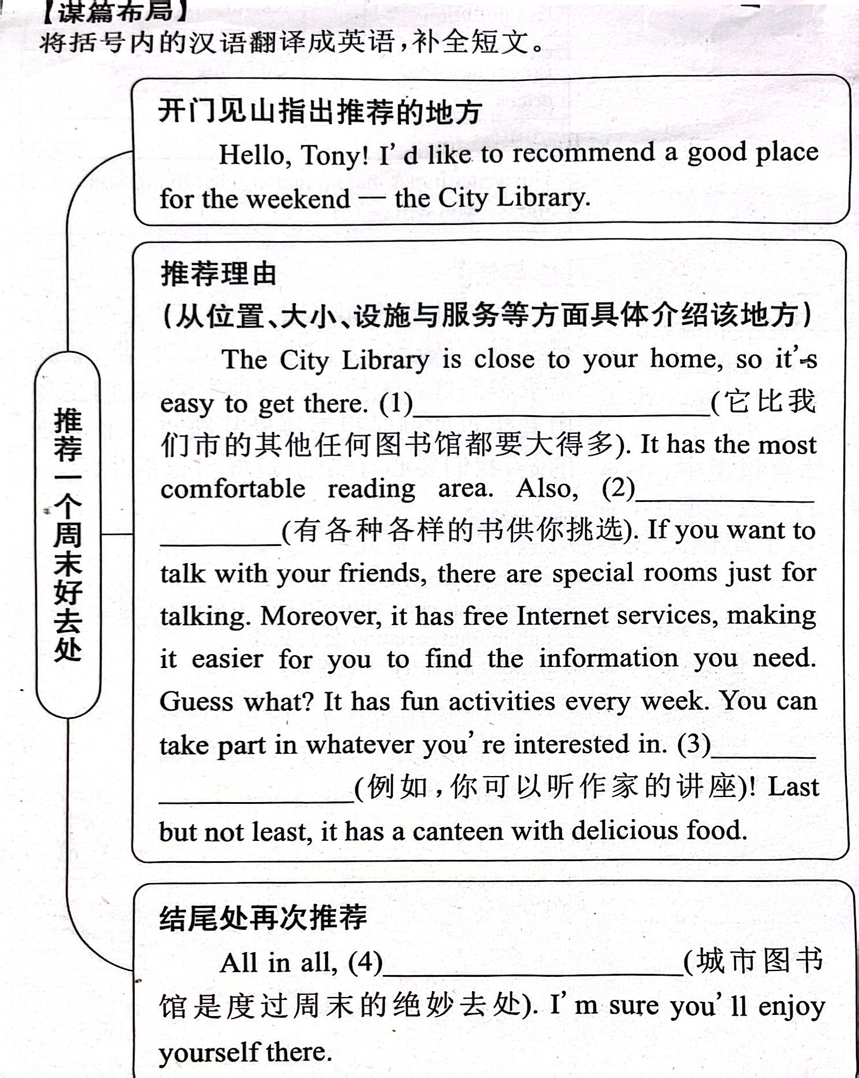

Slide 24
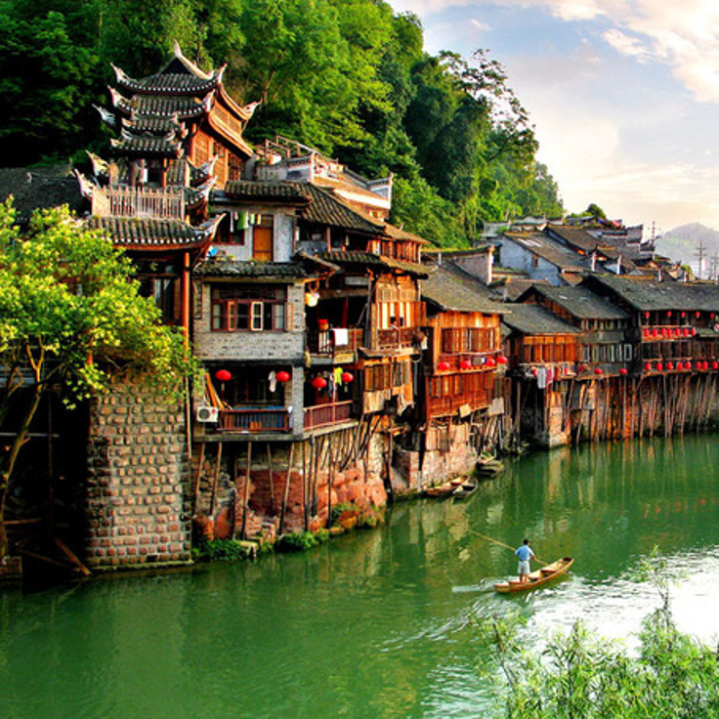

Write about your town and the best places there.
_________________________________________________________________

Slide 25



Discuss the towns / cities in China with a partner. Tell the class which town / city you think is the best.
I think Qingdao is the best city in China because it is the most beautiful. But I think Beijing is the most popular city for visitors.
Which is the best town / city?
… has the best …
… is the best because …
… is better than …, but … is the most …

Slide 26
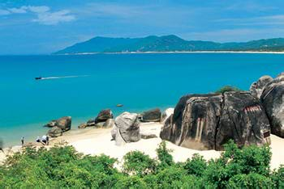
I think Sanya is the best city in China. It has the most beautiful beaches and the cleanest water. It’s the warmest place. You can eat the most delicious sea food. You can enjoy the sunshine most quietly.

Slide 28

本单元要求写居住地最好的地方或事物, 并说明原因。时态应用一般现在时态。
先描述某个地方或某件事物, 然后说明其最好的原因。
正确运用形容词或副词的最高级形式来表达。

Slide 29
3a文章中的第一句话和最后一句话分别起到了总起和总结的作用, 文章通过3个方面的原因来说明了为什么作者说Greenwood Park是周末最好的去处。大家可以仿照3a的结构来写。

Slide 30

I live in Zhouzhuang in Jiangsu. It is one of the oldest and most beautiful towns in China.
There aren’t many roads in Zhouzhuang, and I think that’s the best thing about this town. We don’t have cars and buses because we use boats to get around town. Many people visit the town throughout the year, and they enjoy going on the boat tours to see the entire town.

Slide 31
There are many special snacks for visitors to buy in Zhouzhuang, such as sesame cakes and walnut cakes. Visitors should also try the wansan pork shank, the most famous dish in Zhouzhuang. To me, the best place to eat wansan pork shank is my father’s restaurant. It is in the center of the town and everyone knows it. It is very crowded in summer.

Slide 32

How many famous cities do you know in our country?
Beijing (capital city, famous, popular)
Xi’an (famous historical city)
Qingdao (beautiful city buildings, fresh seafood)
Chengdu (pandas, delicious food)
Hangzhou (beautiful, love story)
…

Slide 33


根据短文内容，从方框中选择恰当的单词填空，注意形式变化。
theater, together, serious, give, ticket, love, pretty, close
Lucy is Judy’s best friend. Now, Judy is in her room, thinking about what to give to Lucy for her twelfth birthday. Judy takes it very (1)________.
Mrs. White comes to Judy’s room, saying, “Dear, it’s (2)_______ to ten o’clock. It’s time to go to sleep.”
seriously
close

Slide 34
theater, together, serious, give, ticket, love, pretty, close
Judy says, “Mom, tomorrow is Lucy’s twelfth birthday. I want (3)_______ her something special as a birthday gift. I’m thinking about it.”
Mrs. White sits on Judy’s bed and says, “Tomorrow is March 27th. Ah, I have an idea. Why don’t you buy two (4)_______ for the new play (戏剧)? Then, you can go to watch it (5)_______.”
“Well, sounds like a (6)_______ good idea! Lucy (7)_______ watching plays. But Mom, how did you come up with this idea?” says Judy.
to give
tickets
together
pretty
loves

Slide 35
theater, together, serious, give, ticket, love, pretty, close
“Do you know what World (8)_______ Day is? People celebrate (庆祝) it on March 27th every year.”
“Really? Thank you, Mom,” says Judy.
“You’re welcome. Have a good dream! Bye!” Then, Mrs. White walks out.
Theater

Slide 36


Write a passage about your city and the best places / things there in 60 words.

Slide 37


